Slide 1

Mekko Retail Inc Report

Slide 2
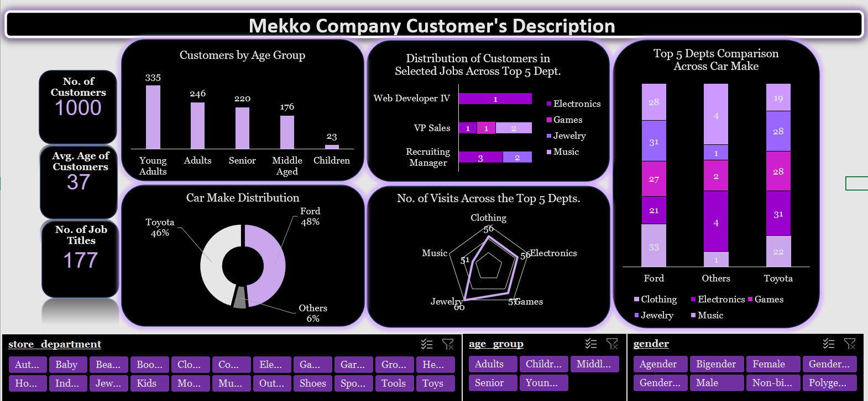

Slide 3
Insights Generated
The total number of customers that patronize the business is 1000;
The average age of the customers is 37;
The customers identify under six different genders;
The male and female genders make up the highest percentage of the population;
The customers drive different types of cars. However, the most popular cars are Ford and Toyota which make up a total of 48% and 46% of the total customer distribution respectively;

Slide 4
More Insights Generated
The ages of the customers are classified into five different age groups;
The Young Adult age group has the highest number of customers and the children age group has the lowest number of customers;
The Young Adults mostly patronize the Electronics, Jewelry, and Sports Department;
They mostly drive Toyota cars;
The store has several departments. However, the top five departments based on the number of customers they have include jewelry, games, electronics, clothing, and music;
The clothing department is hardly patronized by people with more sophisticated job titles;

Slide 5
Recommendations
The company needs to do a deep dive into the electronics, jewelry, and sports departments to find out what the Young Adult age groups are interested in and increase the quantity of those items;
Increase the sales of products relating to Toyota and Ford in the automotive department to entice customers that drive those cars to that department;
Expand the clothing department by including more formal outfits;
The company can partner with automobile industries like Ford and Toyota mechanics to give a certain percentage of discounts to customers who purchase goods worth a certain amount.

